Slide 1

Clear as FUD
Hello, Circle City Con!
Rev. for June 2015

Slide 2

A Bit About Me…
Christopher Maddalena
@cmaddalena
  B.S. in Information Security and Intelligence from FSU
  10 years in IT
  ~8 of that managing helpdesk-type services
Notes:
For those of you who don’t know me, my name is Chris Maddalena
You can find me on Twitter and IRC as @cmaddalena
I hold a B.S. in Information Security and Intelligence from FSU
I have 10 years in IT
For most of that, I’ve been involved with help desk/tech support for clients, customers, and coworkers
When you do that sort of work, you get a good idea how the general public understands technology

Slide 3
What’s on Deck
How the users understand technology
How this understanding is influenced by the media and our daily lives
How this impacts the users and the security field
A look at a few recent examples of this impact
Notes:
And that’s what I want to discuss:
How their understanding is different than ours
How it is influenced by the media they consume,
and how that impacts the security field and our laws.
We’ll discuss some recent real world examples near the end.

Slide 4
Training vs. Education
These are different
Training: Intended to raise awareness and provide guidelines/advice
Education: Just like training, but it takes longer because it explains WHY
Notes:
Users receive training from multiple sources: their employer, social interactions, the media
Training hopes to raise awareness, but it lacks a key ingredient: WHY, WHY any of it is important and WHY it’s relevant to them
Education goes a step farther and explains WHY
We have something interfering with the ability for trainees to learn and become educated, the media they consume that warps their touchstones and leads to a hazy picture.
We’ll come back to that

Slide 5
Why is this Relevant?
“Computers, and computing, are broken.”
-Quinn Norton
Everything is Broken
Notes:
Why is it relevant?
Our topic affects everyone, especially younger generations, teenagers who are just getting into technology
To quote Quinn Norton, technology is broken
Everything we’ve built was built upon fundamental tech that in many cases is being stretched well beyond what it was initially designed for. Think of email.
We need to teach with that in mind, use it as a jumping off point. It’s crucial to understanding security.
If users remain uneducated, we’ll see worse and worse repercussions
Look at Metasploit licensing, CFAA, Wassenaar
It’ll get worse

Slide 6




Ease of Use & Motivation
It’s the touchscreens, constant connectivity, and social media
Notes:
Broken or not, we’re seeing wonderful new stuff becoming available to consumers
Easy to use technology and the motivation to use it
Douglas Engelbert called touchscreen point and grunt interfaces, but they’ve enabled users who struggled to use a PC to get out there and use the internet
Phones and tablets have opened up the internet like never before to people who used to have trouble doing much with a PC
Users live in less of a bubble, they feel comfortable enough to explore
The downside of this awesome change is the users don’t understand what they’re using. Devices are little black boxes of magic.

Slide 7
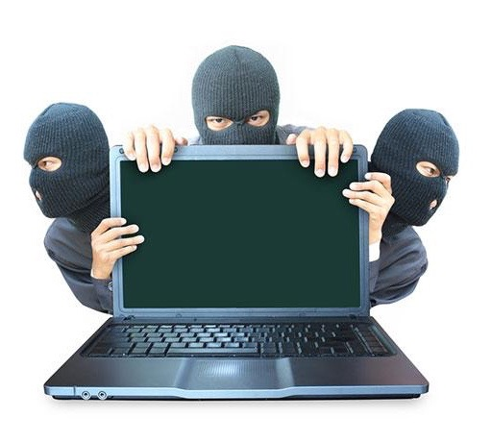
The Downside
A lack of understanding…
Makes them easy targets for scammers
May recklessly expose their PII
Puts them at risk when a device is lost
Has the potential to generate fear
Notes:
A lack of understanding makes the less savvy users easy marks
Phishing, malware, drive-by-downloads
Passwords are being created with touchscreens, small devices, and gamepads in mind
They don’t understand, so they’re reckless or they learn to fear tech
Misunderstood technology can be dangerous because it can lead to costly mistakes, but technology that is feared is terrible for everyone
It leads to blind, uneducated decisions and ideas
Something has to plant the seeds that grow into the fears, though

Slide 8
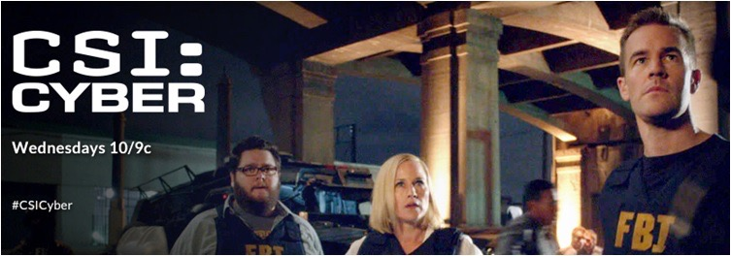



Counter-programming
Entertainment & News
A Q&A with the hackers who say they helped break into Sony’s network
Snowden Used Low-Cost Tool to Best N.S.A.
Meet The Hackers Who Sell Spies The Tools To Crack Your PC (And Get Paid Six-Figure Fees)
Notes:
I call it counter-programming
It’s our education vs. the counter-programming, corporate training and friendly advice competing with whatever they read on Facebook and see on CSI:Cyber
Of course people know CSI isn’t REAL, but it creates a grey area

Slide 9
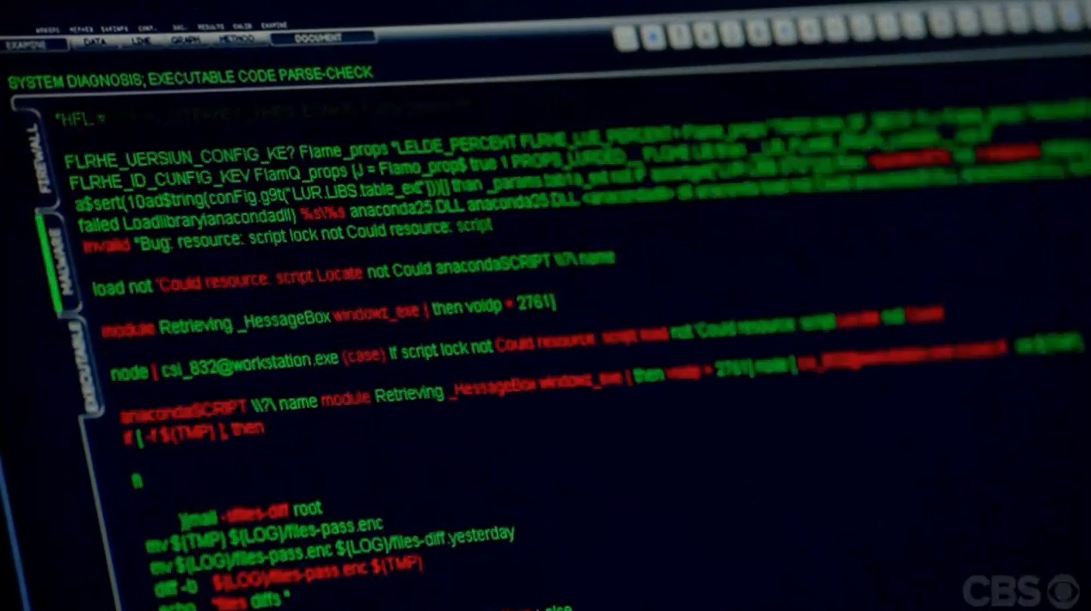
Warped Touchstones & Facts
Touchstones should…
  Aid in communication
  Carry meaning
  Complete a picture
Counter-programming that is…
  Aiding in miscommunication
  Spreading fear
  Offering an incomplete picture
Malware is always red, so you can find it
Notes:
This leads to warped touchstones and facts, like I mentioned earlier
Our touchstones, like the word “hack,” should aid in communication. Touchstones do this by giving us a picture with just a word or phrase. They’re weighty; they carry meaning.
If I ask you, “Did you see that hack on the news?” You know I’m not trying to insult a news anchor. Your mind immediately jumps to our definition of “hack”.
The media, in all its forms, is taking our keywords and warping their meanings, but we’re stubbornly using them as if they still mean what we think they mean when we talk to users. This renders them largely ineffective when speaking to regular users.
We are using words to which the users are assigning a different meaning or idea. To them, Hackers are always bad people who should be stopped.

Slide 10
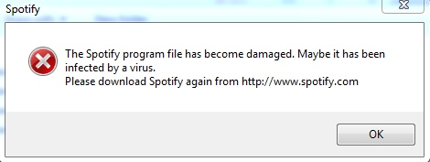
But It’s Not Just The Media
Thanks for the FUD, Spotify
Notes:
But lets take a moment to acknowledge there’s a lot more of this out there NOT produced by the media and TV networks
Lets take a closer look at the evolution of one of our most used words…

Slide 11
What’s a Hack, Anyway?
Someone hired for routine work
A prankster and/or tinkerer
Prostitution & Taxis
A hack, hackney
Hack, a brief history
Notes:
This is an abbreviated version of how one of our favorite touchstones has changed over the centuries
Words change with time… with use.
Once a word is introduced into our everyday lexicon, it starts to change.
There’s been a tug-of-war over the word ever since 84
Early 13c
1300—Worker or horse for hire
1500—Prostitute
1700—Taxis
1800—First recorded use of hack as an insult, e.g. hack writer
1960—MIT students say they remember it used to refer to pranks
1976—Someone who enjoys programming for its own sake
1984—One who gains unauthorized access to computer records

Slide 12
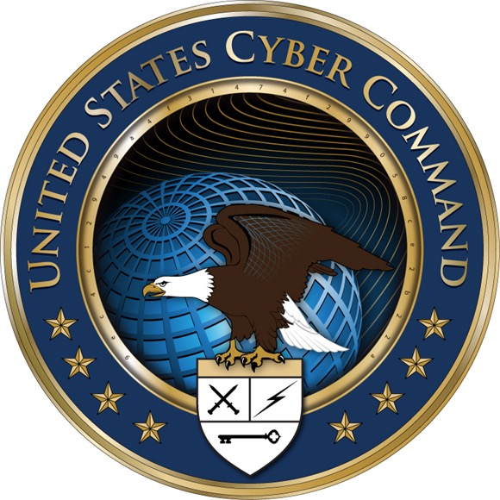
If it’s on a patch…
“If the word is on a patch on somebody’s shoulder,
we’ve probably lost.”
-Alex Stamos, Yahoo! CISO
Notes:
Lets consider everyone’s favorite keyword to hate, “cyber.”
We need keywords to be consistent if they are to work for communication
Funny enough, cyber is pretty stable, if perhaps overused and a bit too flexible in its meaning
Hack and cyber are words that mean something different to different groups
The InfoSec community embraces hacker as a word that has flavour and history
It’s positive
We refer to the riff raff as "hackers," but we say it knowing they aren’t “one of us.” They’re miscreants, criminals, or unskilled skiddies.
The community rejects cyber, more or less
With the media, it’s all flipped the other way.
The media uses hack as an all-purpose word for "attack that used a network and a PC"
It’s usually used negatively, and the hackers are bad guys who who assisted with the attack
The media LOVES cyber
[Reference the slide]

Slide 13
We’ve thought like this for a while…
“What word describes someone who breaks into computers? Old style software wizards are proud to be called hackers, and resent the scofflaws who have appropriated the word…
“We’ll always find a few dodos poking around our data. I’m worried about how hackers poison the trust that’s built our networks… a few morons can spoil everything.”
—Clifford Stoll, Cuckoo’s Egg
Notes:
We’ve thought like this for a long time
Consider these excerpts from the Cuckoo’s Egg by Clifford Stoll, circa 1989

Slide 14
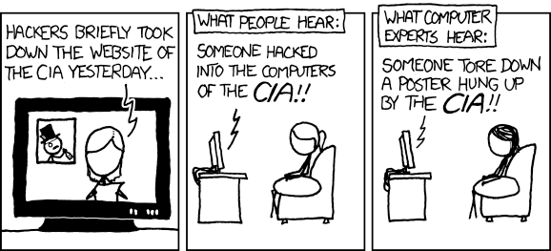
Hax Today
XKCD #932
Notes:
So what is a hack today?
What we would call an "attack" is reported as a "hack" by the media
Hack has become a scary word that encompasses everything from…
DDoS, website defacement, and Twitter vandalism to large scale security breaches involving exfil
These are all events that are being reported as if they are on the same level as the big security breaches

Slide 15
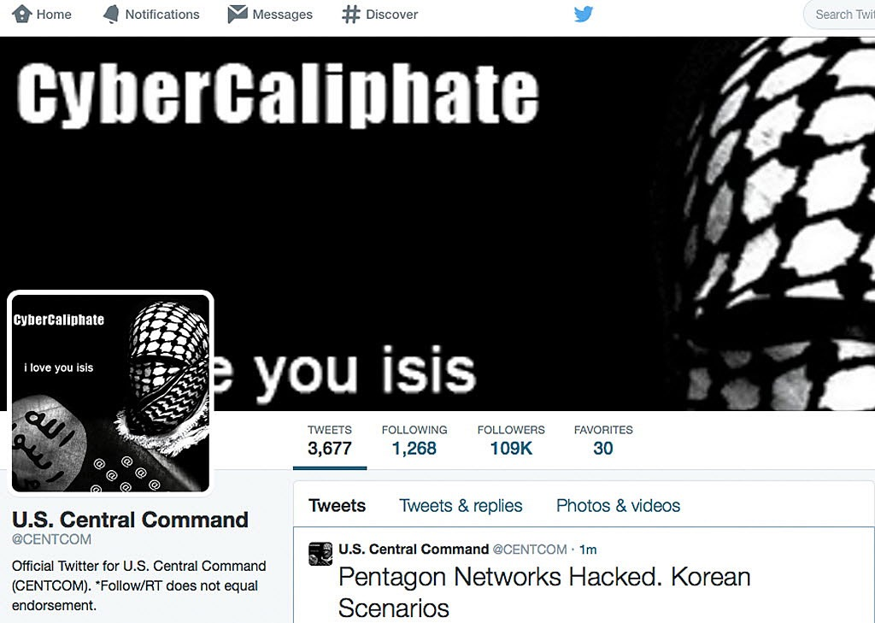
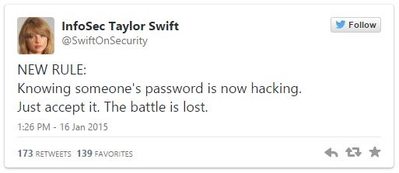
You Are Not Your Twitter
Notes:
WE know CENTCOM was NOT hacked; Twitter was, and even that’s a stretch.
Is knowing or guessing a password for a Twitter account really something we want to see reported as “hack”?
Attacks and vandalism are conflated with security breaches
When Sony Pictures Entertainment was compromised, that was a truly damaging security breach/failure
When Sony Online Entertainment and Microsoft were DDoSed, that was a service outage
Taking advantage of a problem in the internet's architecture vs. bypassing security measures

Slide 16
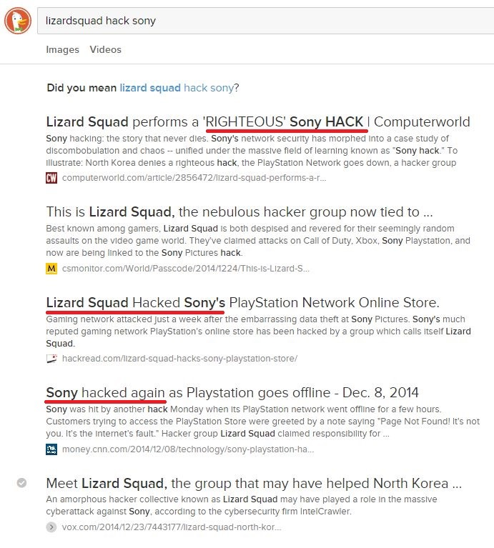
Righteous Hacks
Sony Motion Pictures, an actual breach
CSMonitor gives additional publicity to LS
Sony Online Entertainment, a DDoS
Sony Online Entertainment, a DDoS
Vox gives additional publicity to LS
Notes:
Ridiculous headlines are nothing new, but it’s killing our gains in user education
Look at these headlines: the first is a story about Sony Motion Pictures being hacked by Korea, or whatever, but the rest use the same language and refer to the DDoS
What I want to stress is it’s one thing for an editor to generate a click-bait headline, it’s another for the article to be full of bad information
Still, FUD articles aren’t new, but not many of them affect the reader on a personal level like bad info about security does.
But the journalists aren’t even educated well enough to see that. They’re end users, too.
Recently, journalist I respect moved to a writing for a website known for headlines like this. When asked if he was being forced to write outrageous headlines, he defended it saying they strive to reveal the “emotional truth” of the article. That was profoundly disappointing to me because, in my mind, we want to avoid presenting emotional gut-reactions as the first thing a reader sees
Reference screenshot

Slide 17
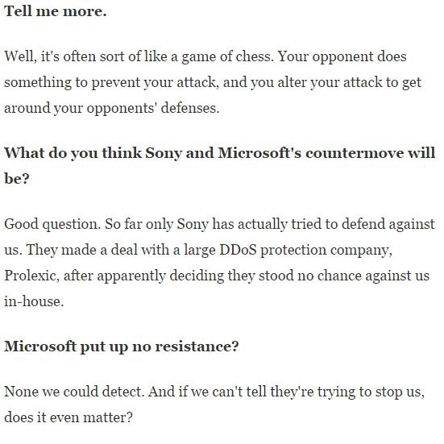
Wut?
Notes:
The problem isn’t just sensationalist headlines. In fact, it’s kind of bad the articles exist AT ALL.
The media attention paid to groups like Lizard Squad worsens the confusion around the “hacks” and makes the groups appear legitimate
WaPo and BBC interviews with LS were the worst
This WaPo journalist was fooled and then presented this terrible interview
Statements like "[Sony] made a deal with a large DDoS protection company, Prolexic, after apparently deciding they stood no chance against us.”
Meanwhile, they aren't taken seriously by those who understand what they really did (e.g. Skiddie Squad, Loser Squad, etc.)
This doesn't matter while the average person is seeing them taken seriously by established institutions they understand and recognize

Slide 18
Cause and Effect
Users become afraid of “hackers” and those like them without understanding infosec
Lawmakers are put under pressure to crush “hacking”
Elected officials want to appear to be doing something
The media and corporate training focuses on enterprise security...
Users don’t recognize this affects them at home
Notes:
Lawmakers and politicians are under pressure to defend against "hacks"
This leads to things like politicians proposing harsher and broader anti-hacking laws, changes to the CFAA, etc.
Media representation of young adults as a scourge of corporations (and the winners in the fight) makes the situation seem dire
This scares/angers people
They want to see "the hackers" pay for their vandalism and mischief, but...
These hackers seem so elusive and numerous
It's unnerving to think kids with laptops are "beating" corporations and security professionals
Users are in danger at home, too. People still expect viruses from the 90’s—massive pop-ups and crazy problems. They don’t realize they might become part of a botnet, R.A.Ts might be used to spy on them, PII might be stolen
They think AV is a silver bullet… “Impossible, Norton is on here, so I’m good.”

Slide 19
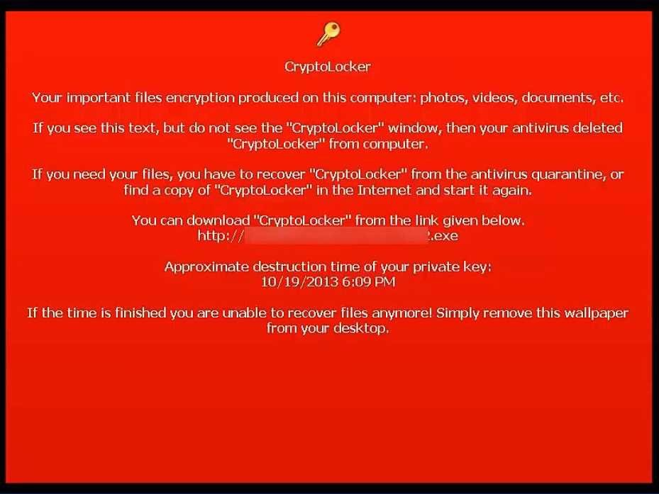
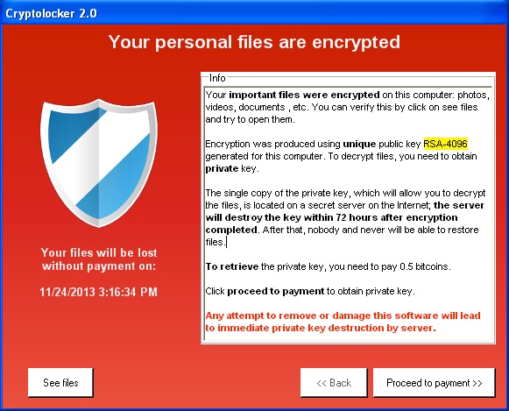
Locked-Up
Notes:
Malware has evolved
Users assume they’re safe if they avoid porn and think their AV will protect them
They'll know if anything gets past it because their PC will be slow and they’ll see odd behavior, like pop-ups.
Now we have CryptoLocker 1, 2, and others
Users don’t even have to do anything unusual to get infected.
One competitor, CrytpoWall, was recently discovered to be using a online ad network to infect via drive-by-downloads and a Flash vulnerability. Users were infected just by being unlucky enough to visit The Huffington Post while the malicious ad was in rotation and before Adobe released an update.
Now TeslaCrypt and others are innovating.

Slide 20
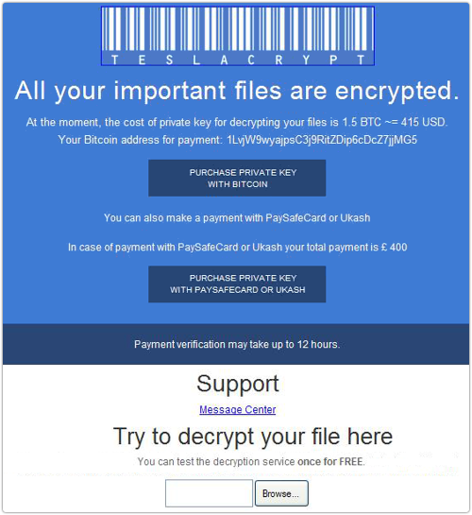
A Public Health Hazard
Notes:
This is the future
Designed with a working barcode, logo, and a color scheme. It offers one free file to prove you’re screwed.
TeslaCrypt is branching out. It’s a business that wants better ROI.
Targeting gamers by encrypting WoW, Steam, saves, etc. and seeking Dropbox folders, connected devices, shares, and other media
This is less of a technology issue than it is a public health issue
The users don’t get that malware has changed and can spread like a disease.

Slide 21

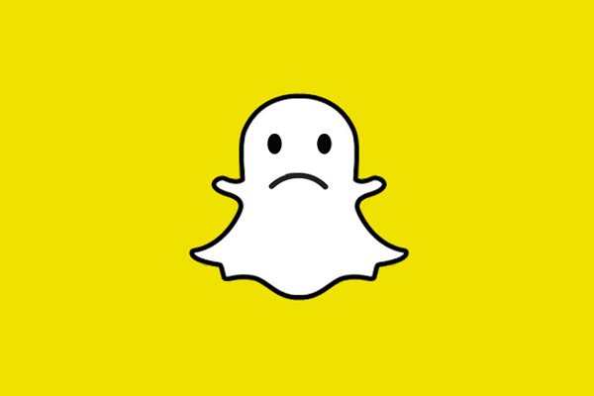
Oh Snap!
“… Snapchatters were victimized by their use of third-party apps to send and receive Snaps, a practice that we expressly prohibit in our Terms of Use precisely because they compromise our users’ security…”
—From Snapchat’s official statement
Notes:
Black Box Services
Another hazard is users not understanding the internet and the services they use. Users aren’t wired to think like us. They’ll trust an appealing idea if it addresses a problem for them, like Snapchat.
Unfortunately, this lack of understanding allowed the Snappening to happen. The release of affected users of 90,000 photos and 9,000 videos stored using the third-party service SNAPSAVED.com.
Snapchat’s response was pretty cold. The blame was on the users.

Slide 22
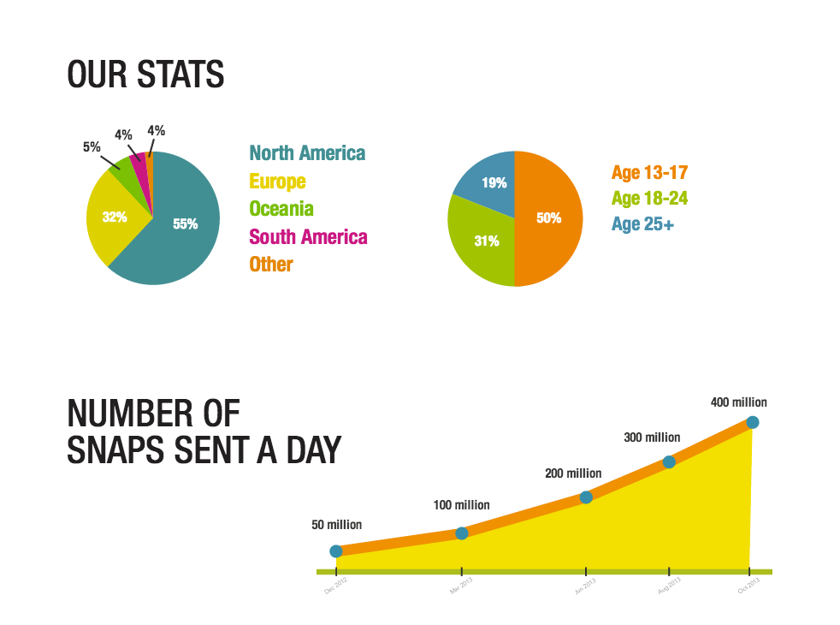
They are the 50%
Notes:
The Demos
I mention Snapchat because this graphic is part of Snapchat’s pitch to advertisers, and relevant to the next example
Snapchat is being used overwhelmingly by 13-17 year old kids, 50%. Another 31% are just 18-24.
Regardless of what’s being sent, what Snapchat offers, self-destructing MMS messages, can’t really be delivered. So the media isn’t safe.
What these kids are sending using Snapchat is not safe, regardless of what they choose to send, and many of them don’t know any better

Slide 23



Hiding in Plain Sight
Central Virginia’s encounter with “self-production”
An incredible misunderstanding of technology
The headlines went a different direction:
                Teen ‘Sexting’ Ring Discovered on Instagram
                Police Bust Virginia Sexting Ring Involving 100 Teens
                Police Uncover Teen Sexting Ring
Notes:
Close Encounters with Self-Production
I said Snapchat was relevant, and this is why.
The facts…
An Instagram account was found by accident
It showcased pictures featuring over 100 teenagers between the ages of 15 and 17. The police described them as ranging from inappropriate to crazy, “they really got us.”
Student interviews suggested a couple of boys created the accounts to stash and collect all of the nude pictures they were receiving from girls at the school.
The account was to be shared, so it was left public with some special hashtags
If you submitted a photo, you got the hashtag. The kids completely underestimated the internet and had no comprehension of what they were really doing: distributing child pornography.
This was Virginia’s encounter with “self-production” — children created child pornography featuring themselves and then distributing it online.
When asked, the kids said 60-80% of the school participated. A recent study of multiple high schools in E. Texas found 28% of sophomores and juniors. If we assume some kids lied, we might be able to call that a third.
There were consequences, bullying and trauma, but fortunately no one was charged
That’s both good and bad. NO ONE was charged for anything.
But it could have been bad. In 2008, an Ohio girl committed suicide when her nude photo was circulated, and the photo was only passed around between a small group.
These teenagers are out most vulnerable group. It’s very easy for them to make a terrible mistake online.

Slide 24
F- is for Felony
Idaho teen paid a DDoS-for-hire service to DDoS his school to avoid taking a test
  Will probably be expelled
  Facing felony charges
But at least he was targeting the school with just a DDoS
‘Swatting’ incident puts Clinton Twp. school on lockdown
Video Game ‘SWATter’ Faces Five Years in Prison
Notes:
F if for Felony
Another of the law colliding with a new fad
Idaho teen DDoSes school and now faces felony charges
But he’s just one of the many teens being caught after this sort of behavior
Other are SWATting and engaging in more reckless behavior

Slide 25
What To Do?
When you find some good information, share it!
  That’s what the bad guys do
  Share videos and articles, your own knowledge, and/or ideas
Release the knowledge from the echo-chamber
  Collaborate with others to create learning opportunities
  Branch out — Go to developer conferences, speak to other departments
  Talk to other departments, coworkers, and your peers
Use language to gain an advantage, find common ground
  Pay attention to the language of the users, like “cyber”
  Be mindful of jargon — Don’t oversimplify, but don’t water it down
Notes:
The best thing we can do is share what we know. We have a wealth of knowledge that has been documented in personal blog posts and conference recordings. Bookmark your favorites and share them when you see an opportunity.
Many great minds are out there trying to educate, but...
It's tough to explain the details in an article or news segment, so we see very specific warnings
News orgs have an agenda and a message they want to spread
Avoid generalizing and try to educate, when you can.
That’s where sending videos and articles can be invaluable
That’s the first step of this next part: releasing what we know from the echo-chamber.
While we often complain about developers and their lack of concern for security, that’s a terrible generalization.
Talk to a developer of their company’s security group
The people you see at cons are not the people that represent security to most. There are whole dev conferences of really smart people we may never work with.
We can talk to them at their conferences and teach them about security from our side
I hear those talks are packed
Finally, pay attention to word choice and decide when it makes sense to change you language for the audience.
We can use “cyber” for good, when it might help get a point across

Slide 26
Chris Maddalena
Thank You!
Clear as FUD
@cmaddalena

Slide 27
Links
Righteous Hacks: http://tinyurl.com/righteoushacks
Sexting: http://tinyurl.com/instagramproblems
Snapchat: http://tinyurl.com/snaphackfail
Reboot It! Episode 9: http://voicesofappalachia.com/reboot-it-episode-9/

